Slide 1
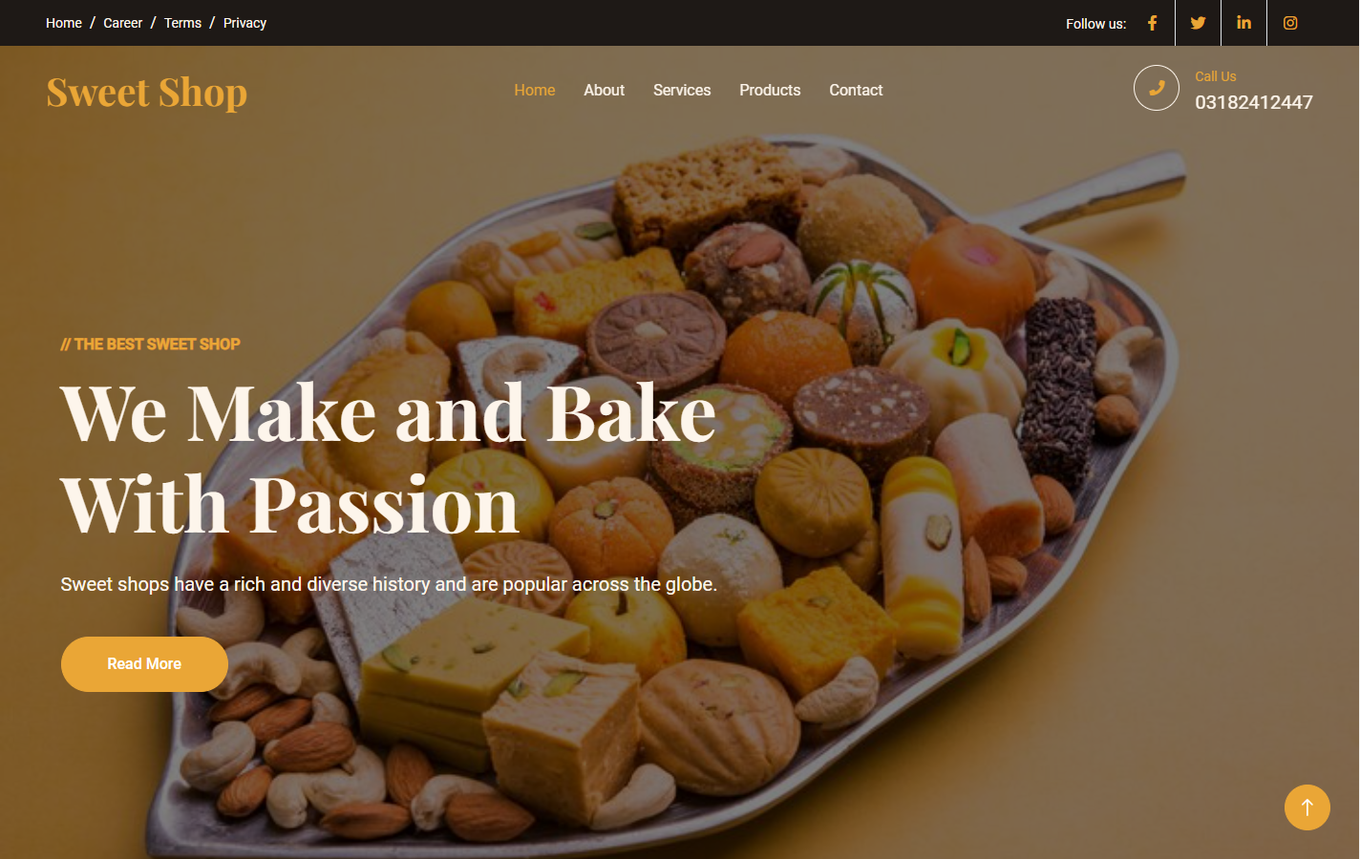
We Make and Bake
With Passion
Sweet shops have a rich and diverse history and are popular across the globe.
Read More

Slide 2
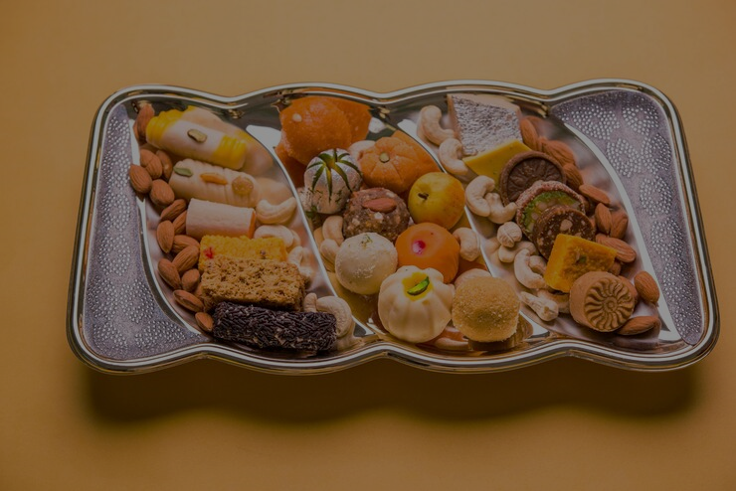
//THE BEST SWEET SHOP
We Make and Bake
With Passion
Sweet shops have a rich and diverse history and are popular across the globe.
Read More

Slide 3
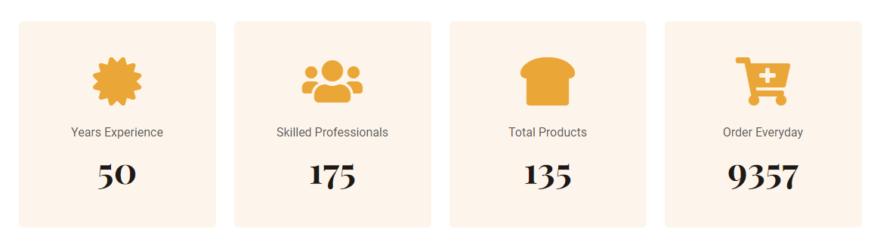
Showing Experience with the help of Counter

Slide 4
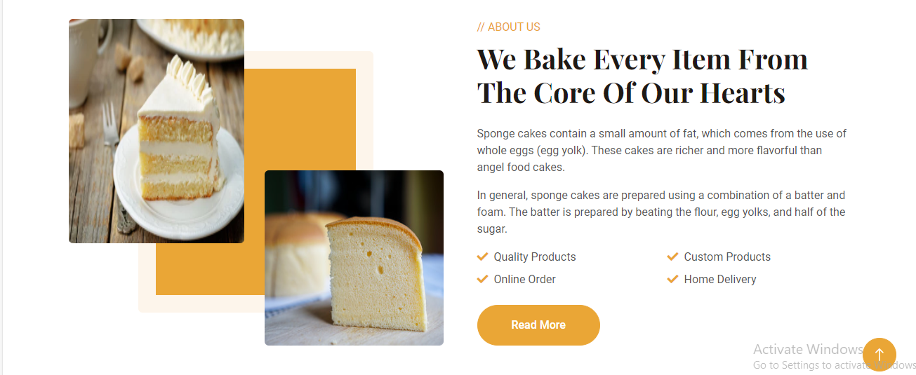
About of Quality and Quantity

Slide 5
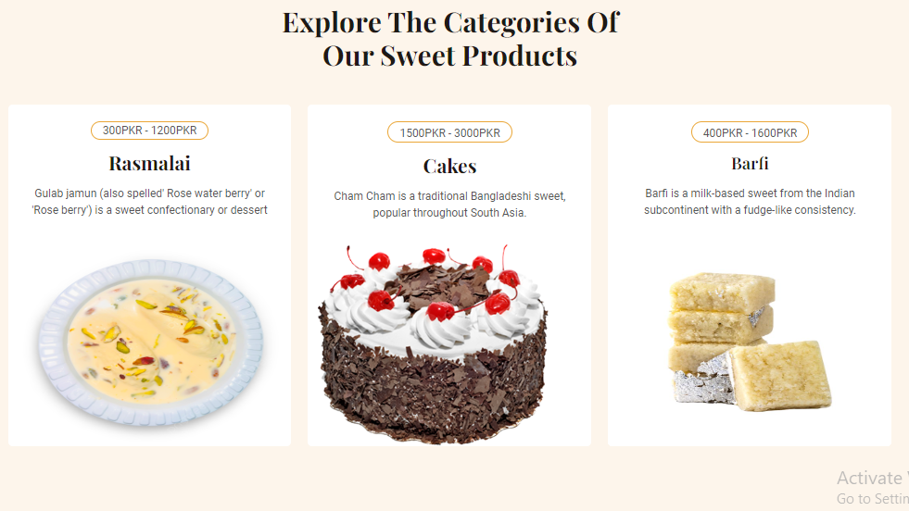
Product what we provide

Slide 6
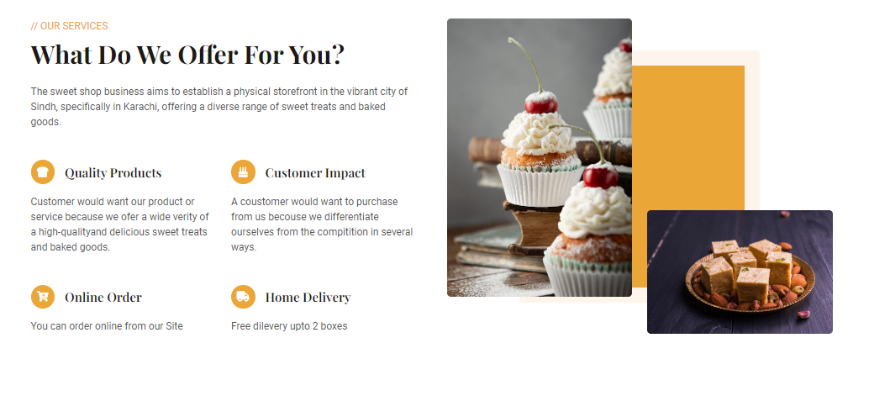
Services

Slide 7
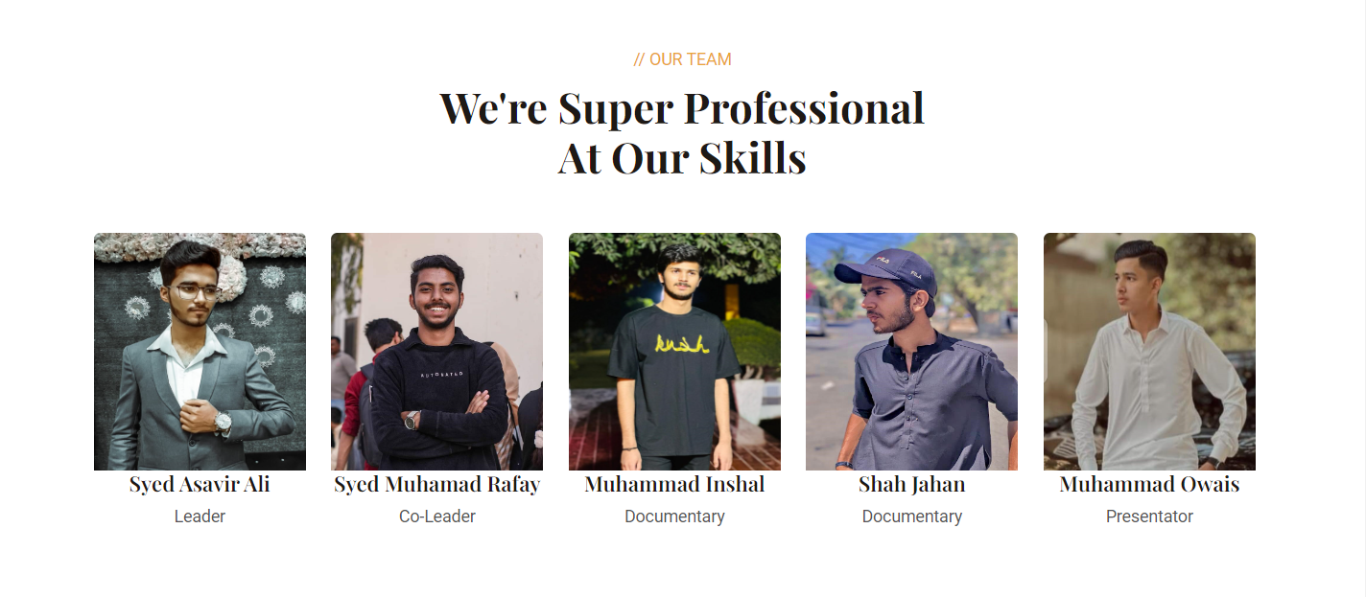
Our Team

Slide 8
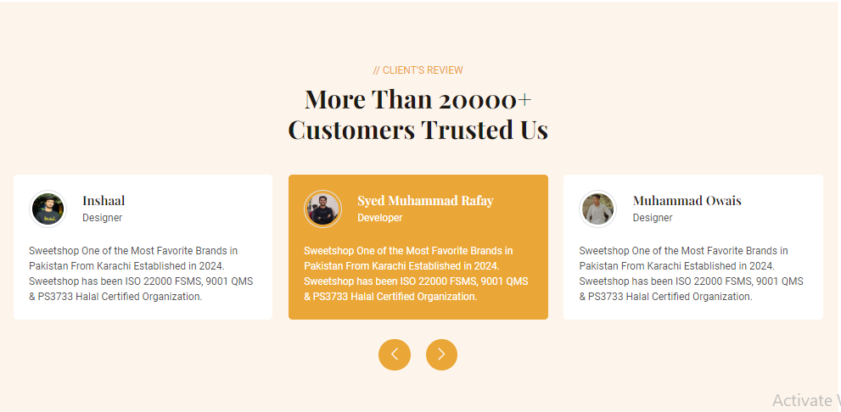
Clients Reviews

Slide 9
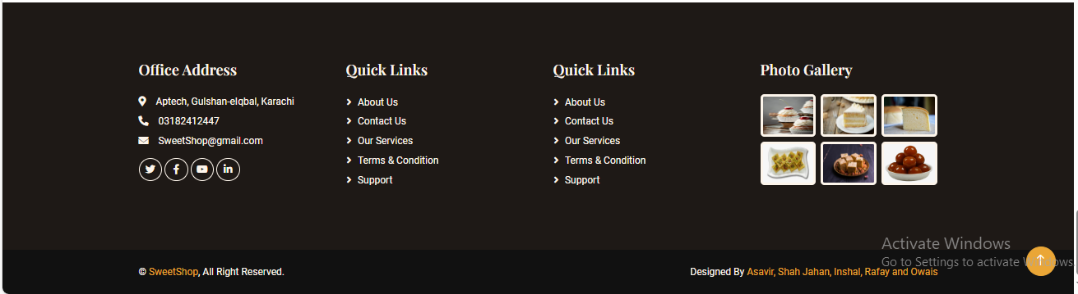
Footer

